Slide 1
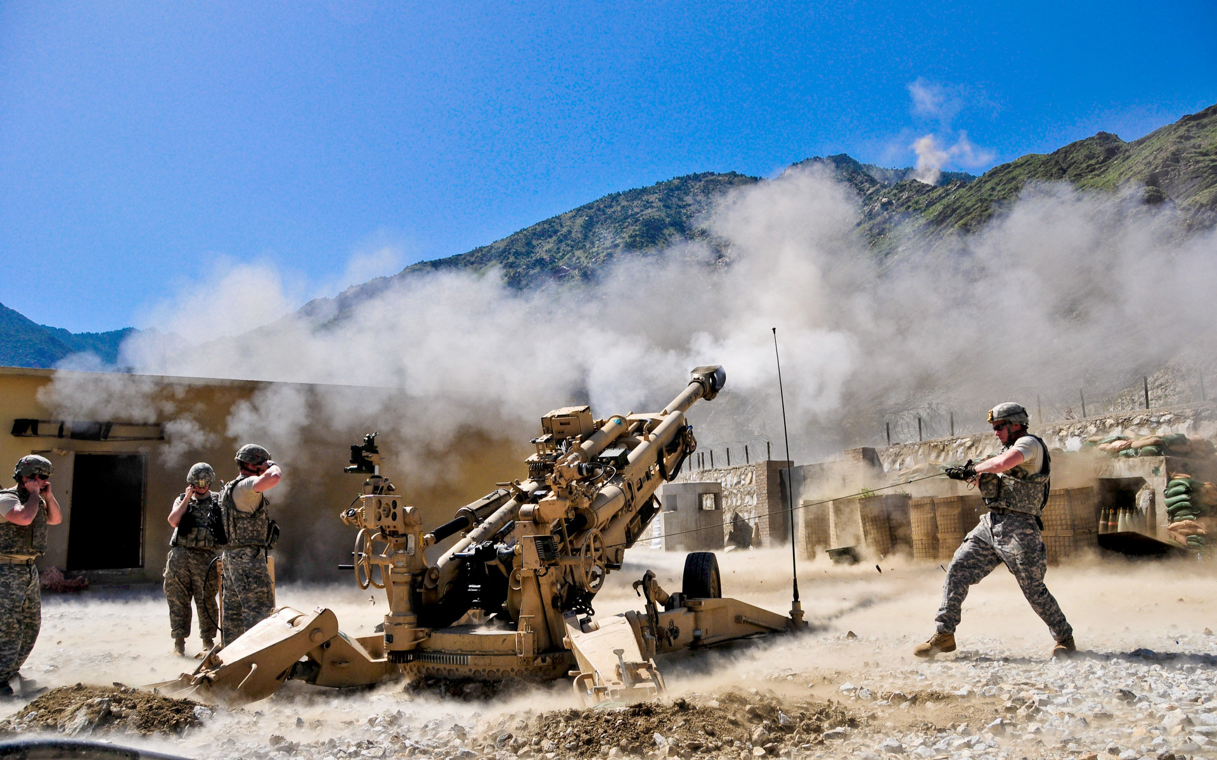
Artillery Fire Guidance Observation System
BY MIST CSE-19

Slide 2
Abdullah Al Masum - 201914044
Md. Samir Hasan - 201914045
Shad Reza - 201914024
Lt Tamzid Hasan Limon - 170214137
Lt Mushfiqur Rahman - 201814104
Group Members

Slide 3
Read Articles
two articles:
1
Target Acquisition Systems Suitability Assessment based on Joint Fires Observer Mission Criteria Determination
2
OPTICAL SYSTEM FOR ANTI-AIRCRAFT ARTILLERY FIRE TRAINING OBSERVATION

Slide 4
From Article 1
To determine the optimal type (variant) of the target acquisition system for equipping the joint fires observers.
Despite the significant technological development of artillery weapon systems and predictions of further reductions in artillery numbers at the expense of other branches, the artillery remains the key fire support element (Šilinger, Blaha, 2017). The findings from current conflicts clearly show the importance and irreplaceability of artillery in the current concept of the armed conflicts

Slide 5
Background of the problem
Target acquisition systems in the Czech army are based on vehicle platforms as well as on backup target acquisition system sets, which are used in case the vehicles are unfunctional. Therefore, both the vehicle platforms and the backup sets are included in the enumeration. In the Czech army, the following systems of artillery target acquistion are currently in use.

Slide 6
Target acquisition method 1
This Sněžka-M system has hydraulically protruded, 3 segmented arm, which carries a senzoric head accommodating target acquisition devices, contains:
Merlin 3 daytime & night surveillance camera;
Falcon-200 digital camera;
THV-3000 thermal imaging camera;
Zeiss LDM 38 laser rangefinder;
Thales Squire ground surveillance radar.

Slide 7
Target acquisition method 2
The LOS-M uses a telescopic arm to extend the sensing head to a maximum height of 4,5 meters. Sensoric head of the LOS-M contains these devices:
Merlin 2 daytime surveillance camera
HK-170 CCD camera
LIRC 640 thermal imaging camera
Zeiss LDM 38 laser rangefinder
Infrared pointer.

Slide 8
Target acquisition method 3
This target acquisition set is based on the GonioLight digital magnetic compass (DMC) complemented by:
Vector 21 laser rangefinder (LRF),
AN/PSN-13A DAGR GPS receiver,
data terminal for processing and transferring of gained data
“Vector 21 Nite” is night vision capable so this device gives target acquisition units night time operations capability

Slide 9
Determination of evaluation criteria
Criteria When using multi-criteria decision-making methods, we distinguish two types of criteria, both quantitative and qualitative. The quantitative criteria are expressed by a numerical value representing the the exact amount of specific value. Qualitative criteria are expressed verbally, because numerical expression is complex or not possible at all.

Slide 10
Criteria Points:
accuracy of own position grid determination;
orientation accuracy;
horizontal angles measurement accuracy;
distance measurement accuracy;
night observation capability;
low visibility observation capability;
speed of system preparation;
laser pointing capability.

Slide 11
Evaluation Criteria
maximal deviation in position determination in meters
maximal angular deviation in orientation in mils
maximal angular deviation in horizontal direction measurement in mils
maximal distance measurement deviation in meters
minimal time needed for target acquisition system preparation in seconds

Slide 12
Determination of Variants
Due to the character of the evaluation of the variants, the criteria were omitted for all variants of the same values. These are the following criteria:
accuracy of own position grid determination;
distance measurement accuracy;
night observation capability.

Slide 13
Conclusion
Since artillery units have recently been equipped with new target acquisition systems, which are characterized as one of the most advanced in current market for military sensors, it is advantageous for the selection of system for the work of JFO to be based on the experience of use of these types. On the basis of multi-criterion evaluation methods of the variants, the implemented means were evaluated according to the needs of JFO

Slide 14
From Article 2
The system is intended for recording images of aerial targets, determining aerial target trajectories, recording images of artillery projectile tracers’ pyrotechnic flares, and determining aerial target firing miss distances.

Slide 15
Instruments
The system is a portable device consisting of a PC computer and two optical heads … each of which consists of:
a) a lens b) a high-speed camera c) a monitor d) a rotation mechanism e) an angle readout system f) a stand as well as a power supply system and a wire set

Slide 16
Instruments in use
The head enables the replacement of the lens, whose selection depends on the distance from the objects being observed and the optical resolution requirements.
The head is equipped with a rotation mechanism with three degrees of freedom.
The PC computer is used for for post-processing the recorded measurement data in order to estimate the coordinates of both the observed targets and the fired projectiles, and to determine their trajectories.

Slide 17
Methodology
During fire training, the flight trajectories of aerial targets are recorded at a speed of at least 100 frames per second by two heads equipped with lenses, with variable focal distance in the range of 150-600 mm.
The measured data is accumulated and filtered, taking into account the kinematics of the projectiles.
Ensures the detection of images of flying projectiles and allows for their location in relation to the aerial targets to be determined.

Slide 18
Thanks!

